Slide 1
Statistics for IT
Sigma Notation and its properties

Slide 2
Learning Outcome
At the end of the module the student will be able to
expand a sum given in sigma notation into an explicit sum;
write an explicit sum in sigma notation where there is an obvious pattern to the individual terms;
use rules to manipulate sums expressed in sigma notation.

Slide 3
Sigma notation
Sigma notation is a method used to write out a long sum in a concise way.
For example, we often wish to sum a number of terms such as
1 + 2 + 3 + 4 + 5
or
1 + 4 + 9 + 16 + 25 + 36
where there is an obvious pattern to the numbers involved.

Slide 4

Sigma notation…
More generally, if we take a sequence of numbers u1, u2, u3, . . . , un then we can write the sum of these numbers as u1 + u2 + u3 + . . . + un .
A shorter way of writing this is to let ur represent the general term of the sequence and put
$$\sum_{r=1}^{n}{u_{n}}$$

Slide 5
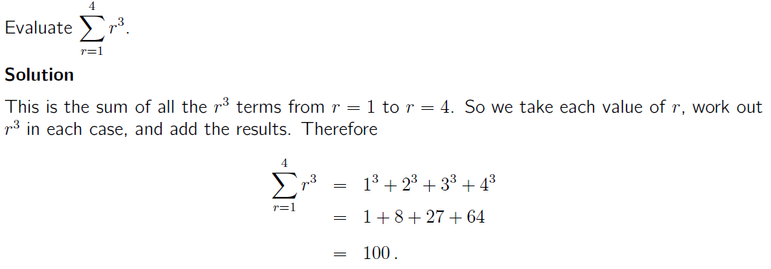
Some examples

Slide 6
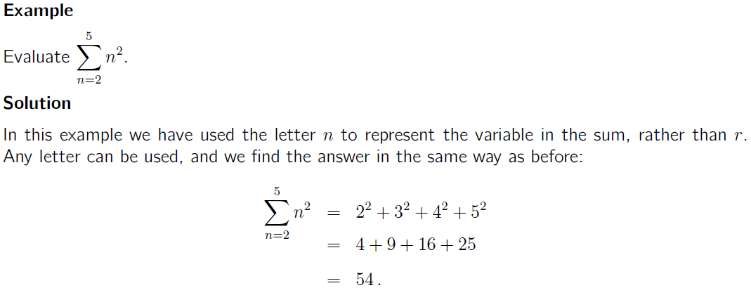

Slide 7
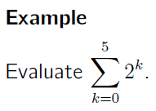
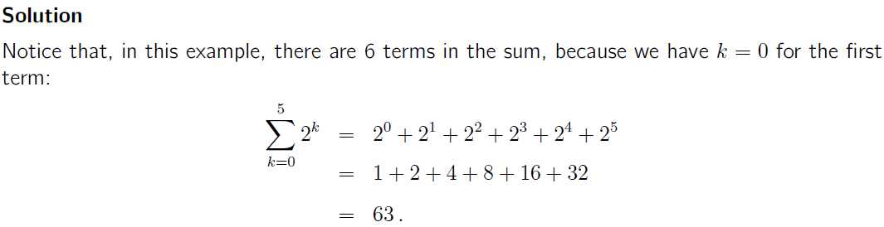

Slide 8
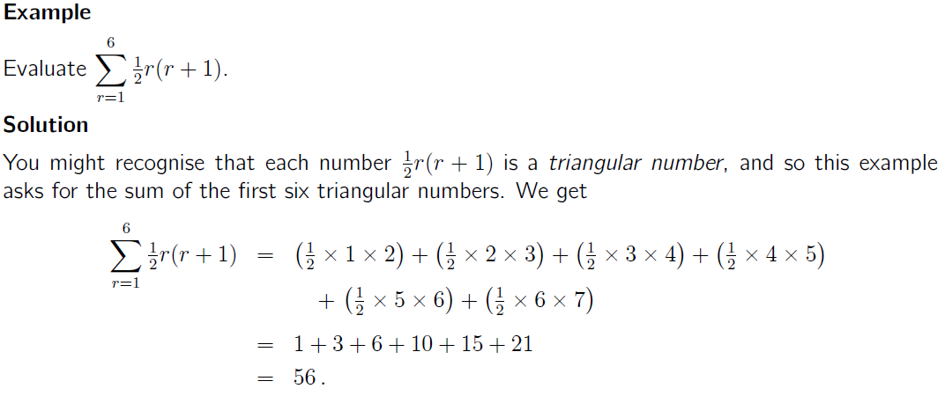

Slide 9
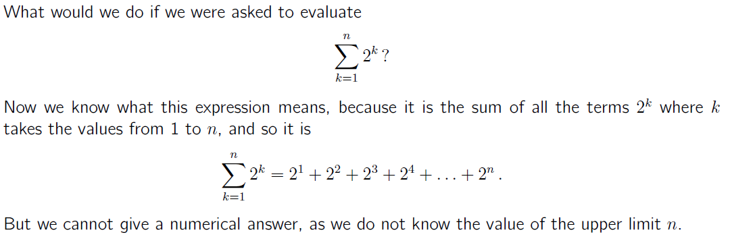

Slide 10
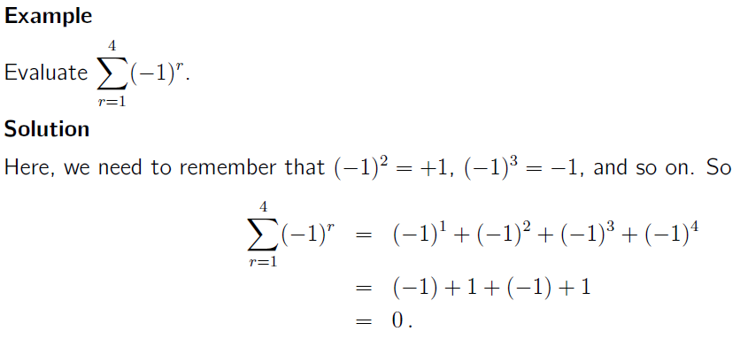

Slide 11
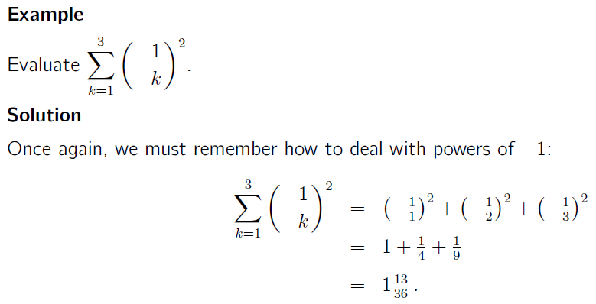

Slide 12


Writing a long sum in sigma notation
Suppose that we are given a long sum and we want to express it in sigma notation. How should we do this?
Let us take the two sums we started with. If we want to write the sum 1+2+3+4+5 and 1 + 4 + 9 + 16 + 25 + 36

Slide 13
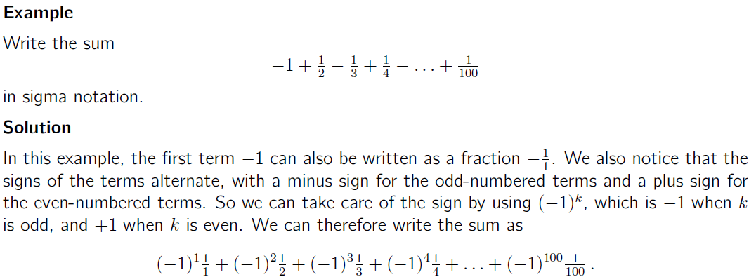

Slide 14
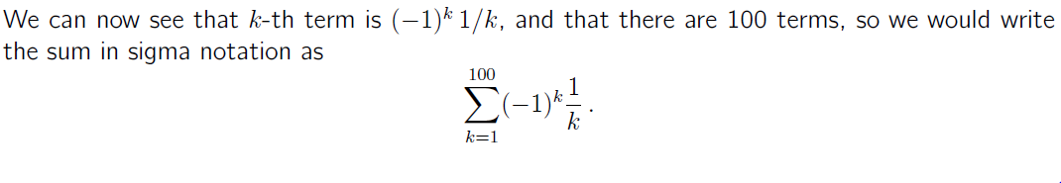

Slide 15

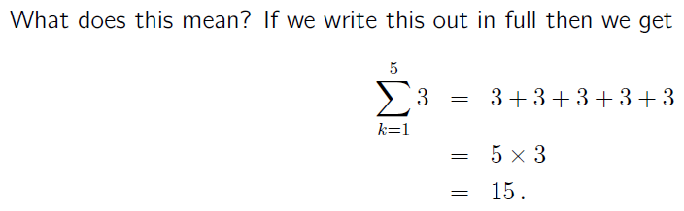
Rules for use with sigma notation
There are a number of useful results that we can obtain when we use sigma notation. For example, suppose we had a sum of constant terms

Slide 16
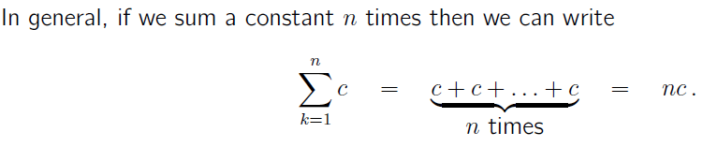
Rules….

Slide 17
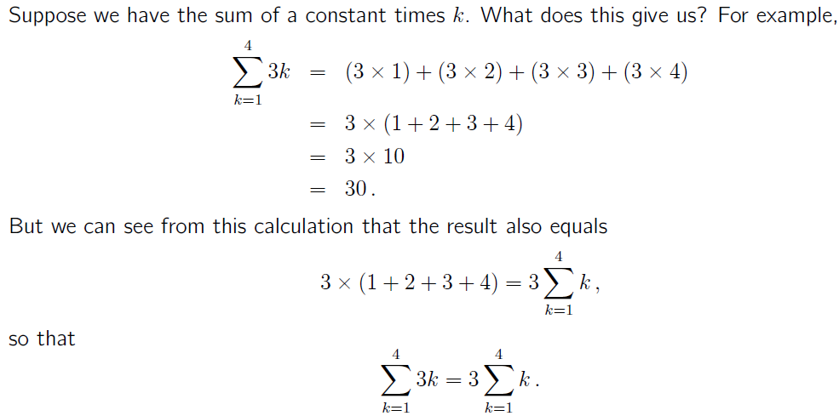

Slide 18
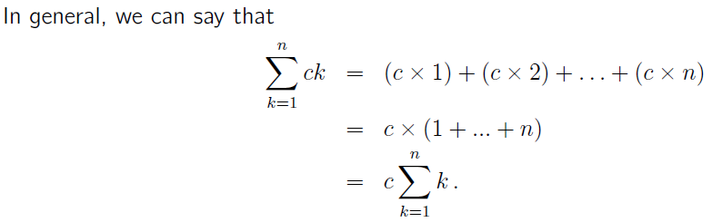
Rules…

Slide 19
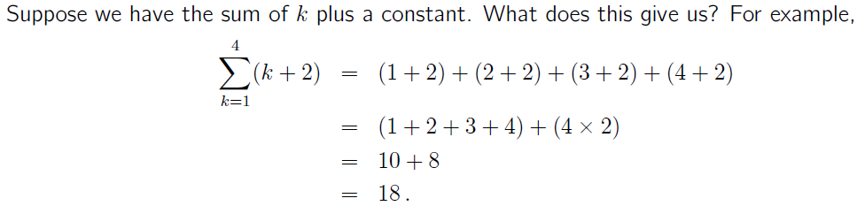
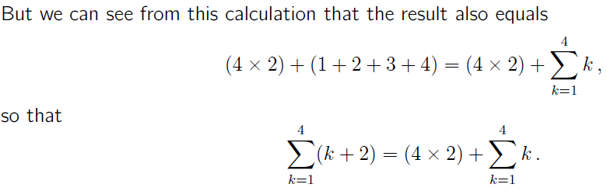

Slide 20
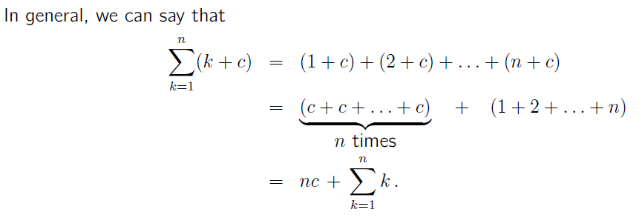

Slide 21

If we have any function g(k) of k, then we can write
Where a is a constant

Slide 22
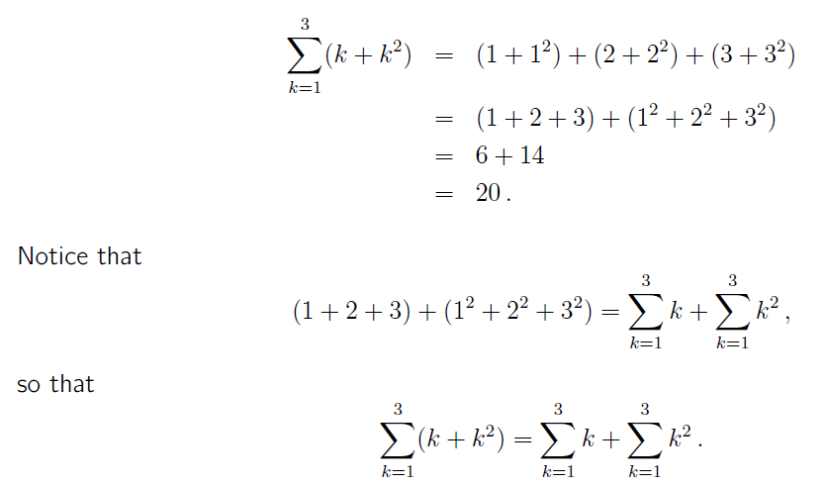

Slide 23
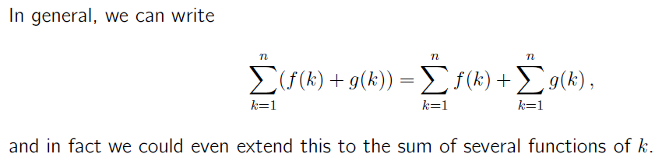

Slide 24
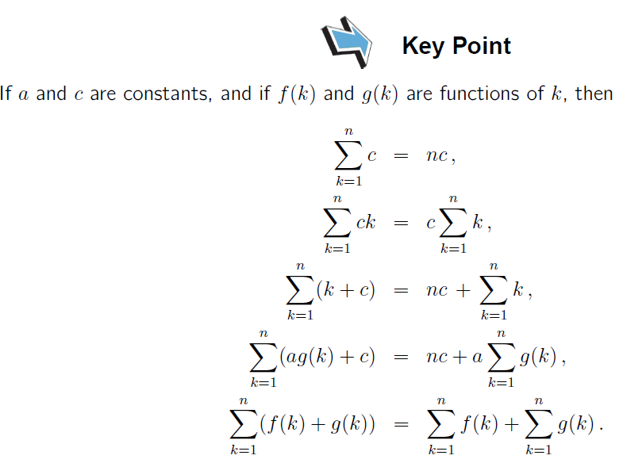

Slide 25
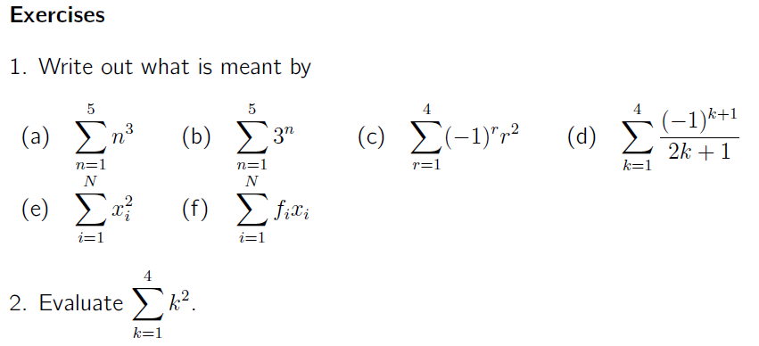

Slide 26
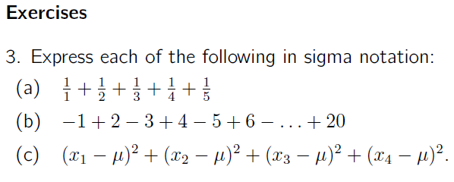

Slide 27
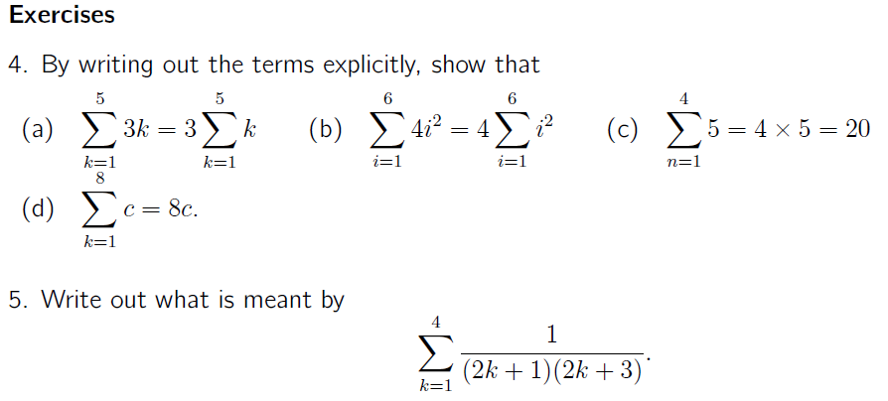

Slide 28
Further Worked Examples

Slide 29
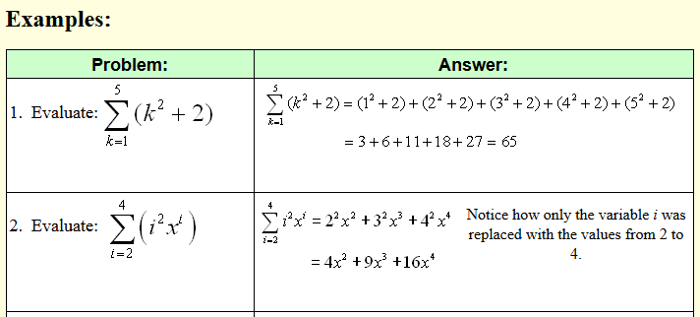

Slide 30
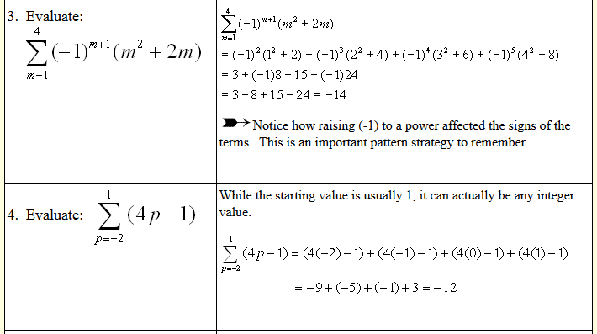

Slide 31
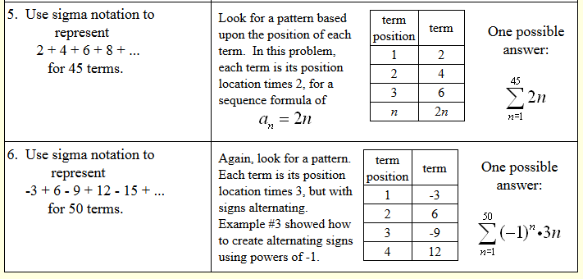

Slide 32
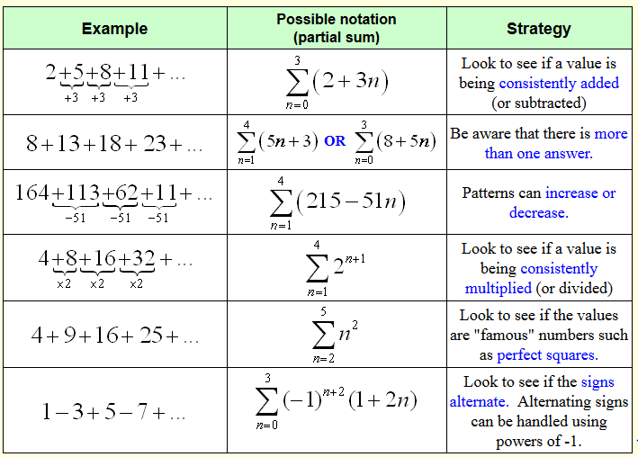

Slide 33
Thank You!

